Slide 1

Secure LLM Agents, Code Vulnerabilities
Casey Fan
Diyana Tial
Mentors:
Dianxiang Xu
Vladislav Dubrovenski

Slide 2
Problem Statement
Problem:
LLM agents and multi-agent systems have unexplored vulnerabilities.
Hypotheses:
Unsafe tool invocation leads to dangerous vulnerabilities.
Insecure agent networks create opportunities for attack.
Research Questions:
How can tools contribute to new attacks against LLM agents?
How can communication systems lead to vulnerabilities in multi-agent systems?

Slide 3

Literature Review
01
02
03
04
LLM Survey (6.2) [1]
Attacks, defenses for LLM agents
Secure Design Principles [2]
Program design with security in mind
Threat Modeling [3]
Finding vulnerabilities in systems
Agent in the Middle [4]
Disrupting agent communication

Slide 4
LLM Survey [1]
Attacks:
Jailbreak, Injection, Backdoor, Manipulation, RAG poisoning
Code Completion attack [5], ToolCommander [6], agent backdoors [7], AUTOCMD [8], AgentPoison [9]
Defenses:
Encryption, output filtering/judging, prevention

Slide 5
Secure Design Principles [2]
Minimal attack surface
Least privilege
Defense-in-depth
Fail-safe stance
Secure by default
Separation of duties
Security through Obfuscation
Robust Resource Management
Forensic Readiness

Slide 6
Threat Modeling [3]
Model functions
Determine threats
Data flow diagram
STRIDE
Rank threats
Mitigate threats
DREAD
Threat tree

Slide 7
Agent in the Middle [4]
Focus on manipulating agent communication
Related Works:
Adversarial agents & tools
Attacks:
Denial of Service
Targeted Behavior
Very High Attack Success Rate (40-100%)
Tested on:
Different frameworks (Autogen, CAMEL, MetaGPT, ChatDev)
Different MAS structures (chain, tree, complete, random)
Different benchmarks (MMLU, HumanEval, MBPP)

Slide 8
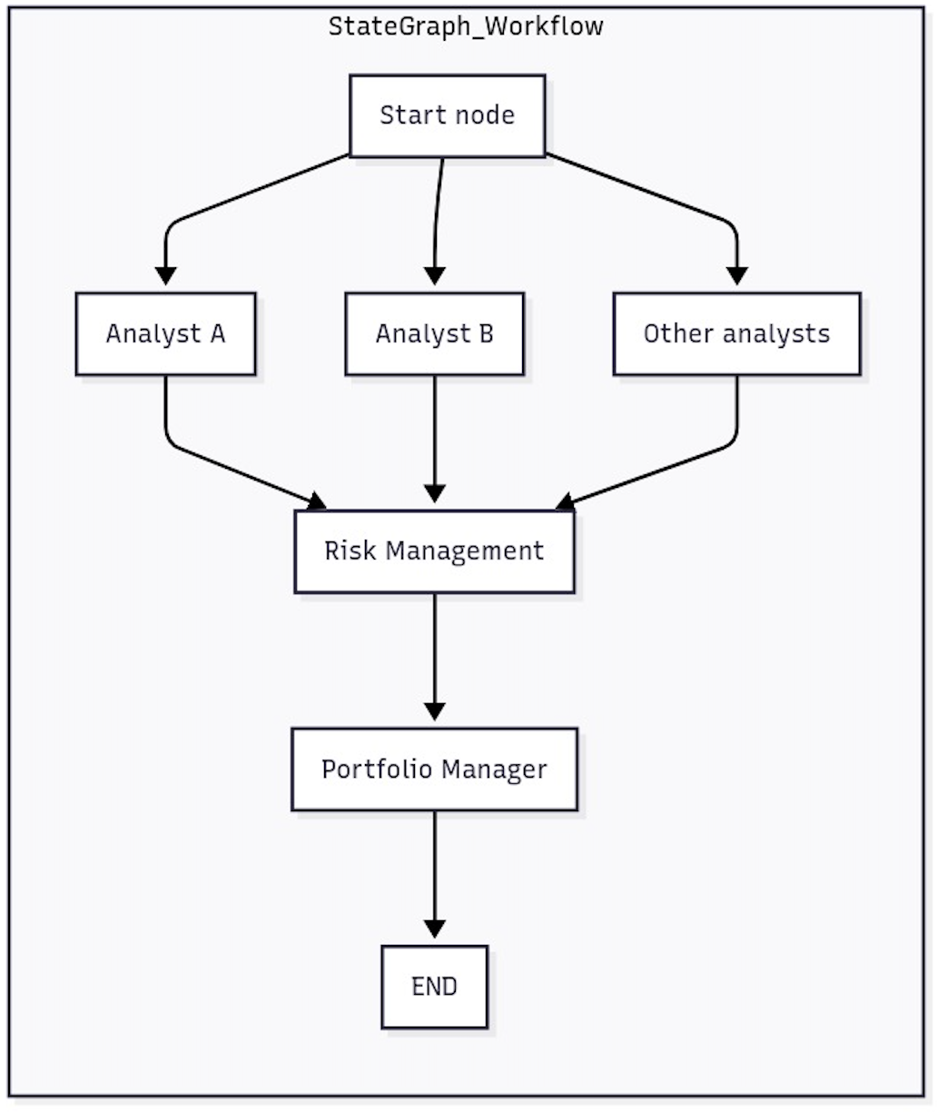
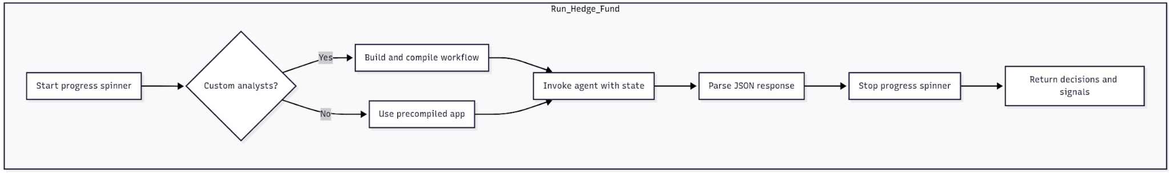
AI Hedge Fund [10] Flow

Slide 9
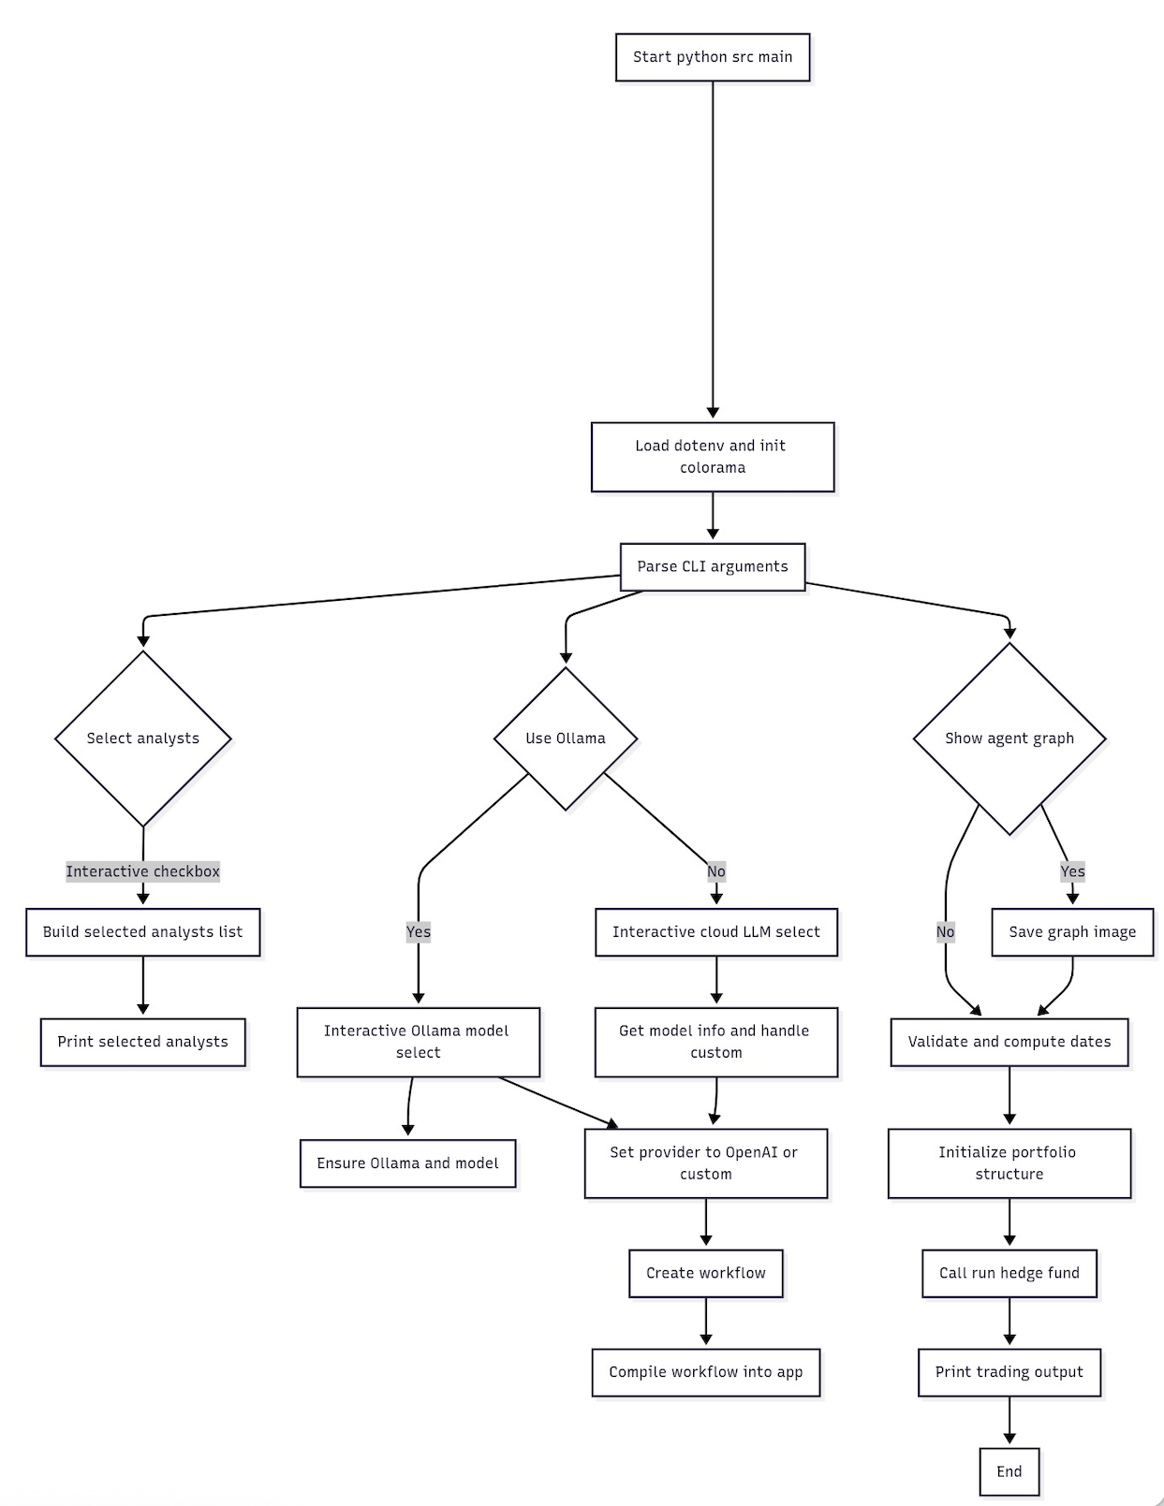
AI Hedge Fund Flow

Slide 10
Future Plans
Diyana:
Agent in the middle attack
Tool injection
Agentcy = multi-agent creative collaboration team of autonomous agents:
Prompt injections
DoS attacks
Casey:
Social behavior of MASs
RAG Poisoning/attacks
Model Fine-tuning

Slide 11
Bibliography
[1] Wang, Kun, Guibin Zhang, Zhenhong Zhou, Jiahao Wu, Miao Yu, Shiqian Zhao, Chenlong Yin et al. "A comprehensive
survey in llm (-agent) full stack safety: Data, training and deployment." arXiv preprint arXiv:2504.15585 (2025).
[2] Xu, Dianxiang. "Secure Design Principles." Presentation, Software Security, Kansas City, MO.
[3] Xu, Dianxiang. "Threat Modeling." Presentation, CS 483/5583 Software Security, Kansas City, MO.
[4] He, Pengfei, Yupin Lin, Shen Dong, Han Xu, Yue Xing, and Hui Liu. "Red-teaming llm multi-agent systems via communication
attacks." arXiv preprint arXiv:2502.14847 (2025).
[5] Cheng, Wen, Ke Sun, Xinyu Zhang, and Wei Wang. "Security attacks on llm-based code completion tools." In Proceedings of
the AAAI Conference on Artificial Intelligence, vol. 39, no. 22, pp. 23669-23677. 2025.
[6] Wang, Haowei, Rupeng Zhang, Junjie Wang, Mingyang Li, Yuekai Huang, Dandan Wang, and Qing Wang. "From Allies to
Adversaries: Manipulating LLM Tool-Calling through Adversarial Injection." arXiv preprint arXiv:2412.10198 (2024).
[7] Yang, Wenkai, Xiaohan Bi, Yankai Lin, Sishuo Chen, Jie Zhou, and Xu Sun. "Watch out for your agents! investigating
backdoor threats to llm-based agents." Advances in Neural Information Processing Systems 37 (2024): 100938-100964.
[8] Jiang, Ziyou, Mingyang Li, Guowei Yang, Junjie Wang, Yuekai Huang, Zhiyuan Chang, and Qing Wang. "Mimicking the
familiar: Dynamic command generation for information theft attacks in llm tool-learning system." arXiv preprint
arXiv:2502.11358 (2025).
[9] Chen, Zhaorun, Zhen Xiang, Chaowei Xiao, Dawn Song, and Bo Li. "Agentpoison: Red-teaming llm agents via poisoning
memory or knowledge bases." Advances in Neural Information Processing Systems 37 (2024): 130185-130213.
[10] Singh, Virat. AI Hedge Fund. GitHub. Accessed June 28, 2025. https://github.com/virattt/ai-hedge-fund

Slide 12

Thanks!
Do you have any questions?
Please keep this slide for attribution

